Slide 1
Lecture-7
Diode Circuit Models

Slide 2
Review
Diffusion Current
Drift Current
Voltage Barrier
Forward Bias
Reverse Bias

Slide 3
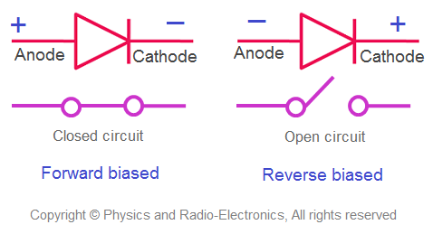
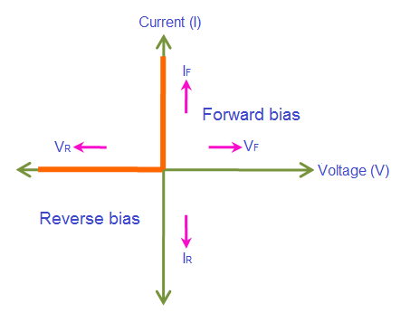
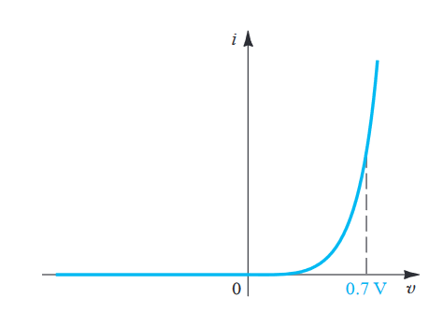
Diode Circuit Models
Ideal Versus Real Diode
Constant Voltage Drop (CVD) Model
Ideal Model
Real / Shockley Model
Low Accuracy
Increased Accuracy
CVD with resistance (CVD+R) Model
Simple
More Complex

Slide 4
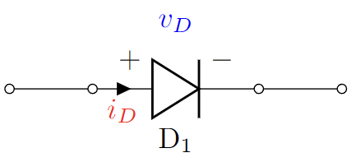
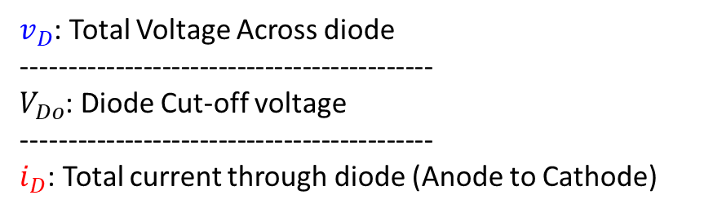


Diode Circuit Models
}
Ideal Diode Model:
Constant Voltage Drop (CVD) Model:
Constant Voltage Drop with Resistor (CVD+R) Model
Exponential Model (Shockley Model):
Piecewise Linear IV Models
$v_{D}$: Total Voltage Across diode
--------------------------------------------
$V_{Do}$: Diode Cut-off voltage
--------------------------------------------
$i_{D}$: Total current through diode (Anode to Cathode)

Slide 5
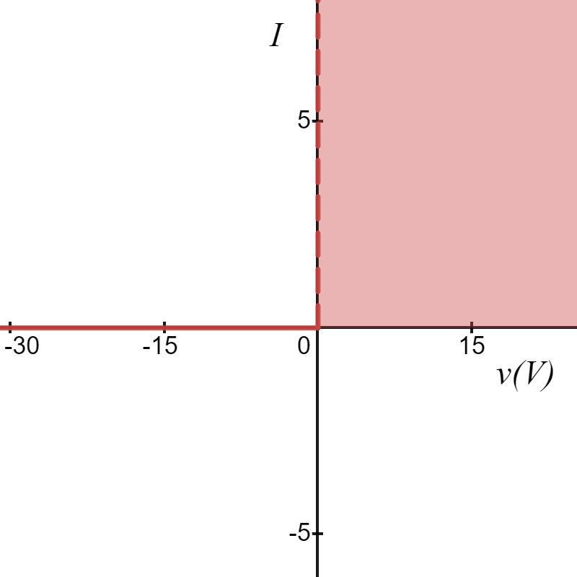





Diode Models
Ideal Diode Model:
$$I_{D}(mA)$$
Forward Bias
$$i_{D}=0$$
$$v_{D}<0$$
$$i_{D}>0$$
$$v_{D}=0$$
$V_{Do}=0$V
$$v_{D}(V)$$
Reverse Bias

Slide 6
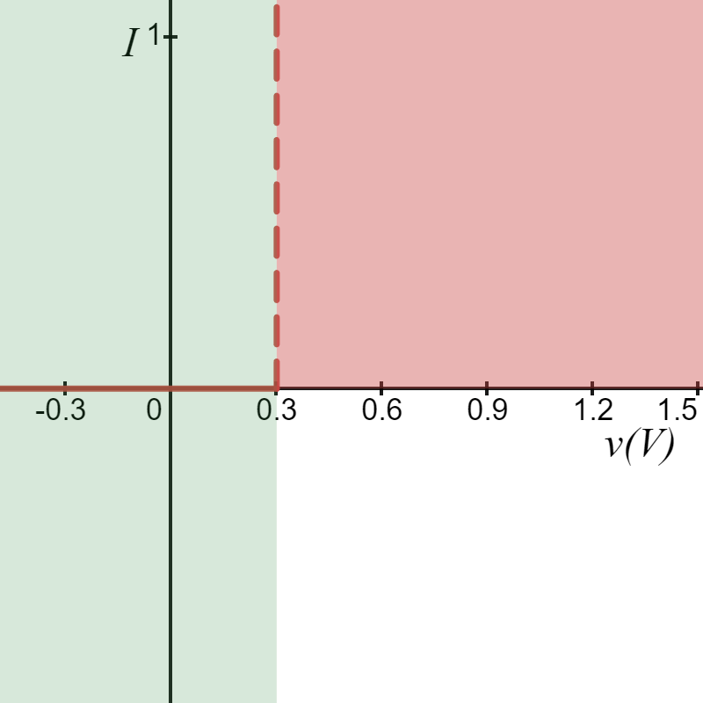
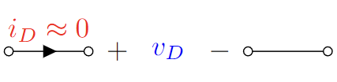
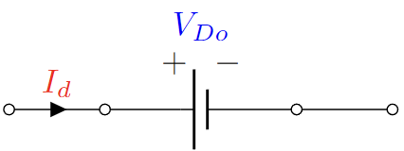




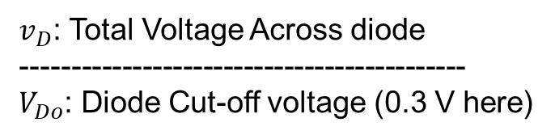

Diode Models
$$I_{D}(mA)$$
2. Constant Voltage Drop (CVD) Model:
Reverse Bias
Forward Bias
$V_{Do}=0.3$V
$$v_{D}(V)$$
$$i_{D}=0$$
$$v_{D}<V_{Do}$$
$$i_{D}>0$$
$$v_{D}=V_{Do}$$
$v_{D}$: Total Voltage Across diode
--------------------------------------------
$V_{Do}$: Diode Cut-off voltage (0.3 V here)

Slide 7




Diode Models
$$I_{D}(mA)$$
2. Constant Voltage Drop (CVD) Model:
Reverse Bias
Forward Bias
$$y=0$$
$$v_{D}=V_{Do}$$
$V_{Do}=0.3$V
$$v_{D}(V)$$
$$x=V_{Do}$$
$v_{D}$: Total Voltage Across diode
--------------------------------------------
$V_{Do}$: Diode Cut-off voltage (0.3 V here)

Slide 8
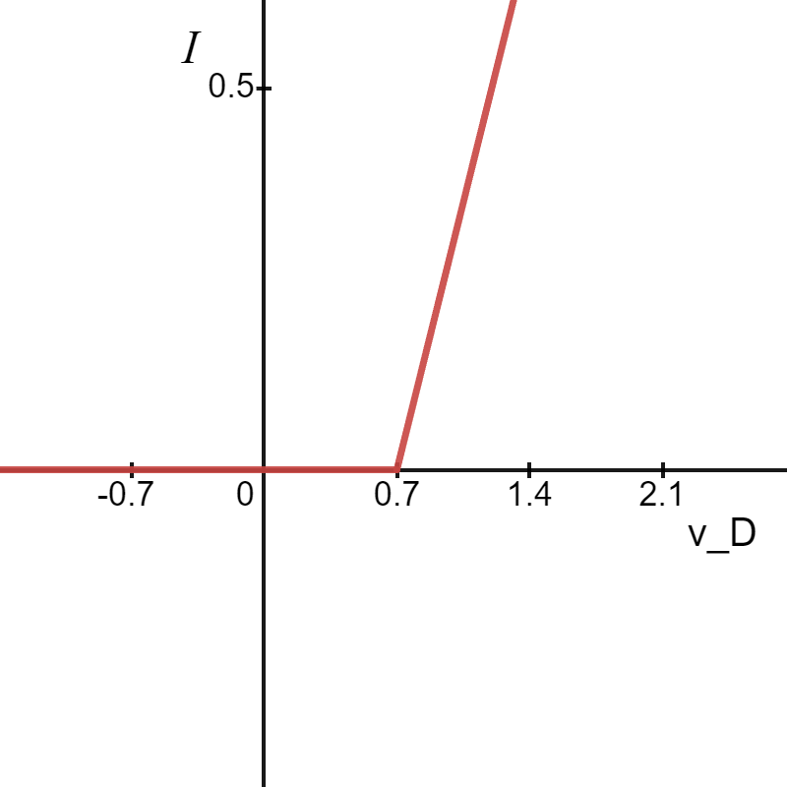
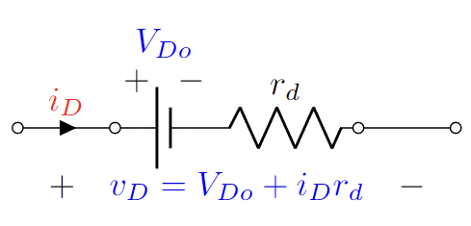

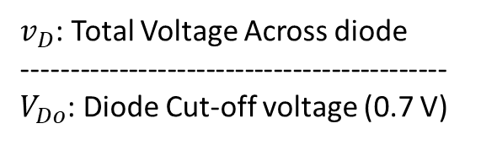



Diode Models
3. CVD+R Model:
$$I_{d}(mA)$$
Reverse Bias
Forward Bias
$V_{Do}=0.7$V
$$v_{D}(V)$$
$v_{D}$: Total Voltage Across diode
--------------------------------------------
$V_{Do}$: Diode Cut-off voltage (0.7 V)

Slide 9
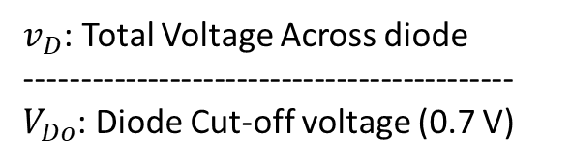




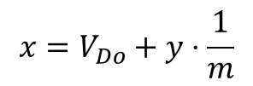
Diode Models
3. CVD+R Model:
$$I_{d}(mA)$$
Reverse Bias
Forward Bias
$$y=0$$
$V_{Do}=0.7$V
$$v_{D}(V)$$
$$x=V_{Do}+y⋅\frac{1}{m}$$
$v_{D}$: Total Voltage Across diode
--------------------------------------------
$V_{Do}$: Diode Cut-off voltage (0.7 V)

Slide 10
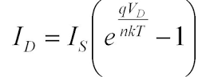
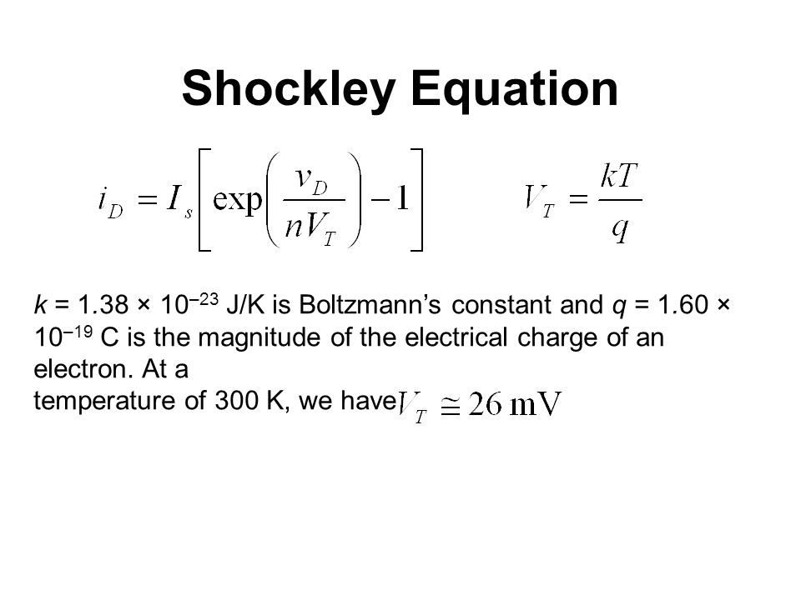


Diode Models
$$I_{D}(mA)$$
4. Shockley Diode Equation Model:
$$v_{D}(V)$$
Where I_{S} is reverse saturation current

Slide 11



Diode Models: Summary
Ideal Diode
CVD Diode
$$i_{D}>0$$
Forward Bias
$$v_{D}<V_{DO}$$
$$i_{D}=0$$
Reverse Bias

Slide 12



Diode Models: Summary
CVD+R Diode
$$i_{D}>0$$
Forward Bias
$$v_{D}<V_{DO}$$
$$i_{D}=0$$
Reverse Bias

Slide 13
Thank You!

